Slide 1
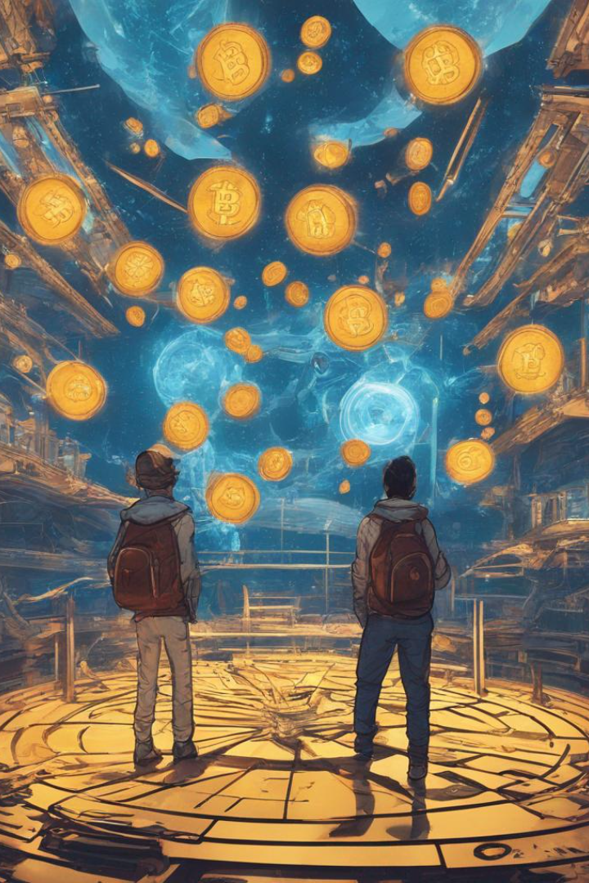
A Review of Non-fungible Tokens Applications in the Real-world and Metaverse
Non-fungible tokens (NFTs) have revolutionized digital ownership. Discover how NFTs are transforming the real-world and metaverse with real-life use cases and limitless possibilities.
by Lavanya Moolya

Slide 2

Explanation of Non-Fungible Tokens (NFTs)
NFTs are unique digital assets built on blockchain technology. Unlike cryptocurrencies, NFTs cannot be exchanged for one another due to their individual characteristics and distinct value.

Slide 3

Applications of NFTs in the Real-World
Music Industry
Gaming and Collectibles
NFTs provide artists with a new way to monetize their work and ensure provenance, authenticity, and uniqueness.
NFTs enable gamers to own, trade, and sell in-game assets, characters, and virtual items securely.
Identity and Credentials
Supply Chain and Traceability
NFTs can be used for identity verification, digital land ownership, and certification of educational qualifications and license Music Industries.
NFTs ensure transparency and traceability in supply chain management, reducing fraud and counterfeiting.

Slide 4

Research Papers on NFTs
Paper Name
Author
Publication
Methodology
A Review of Non-fungible Tokens Applications in the Real-world and Metaverse
Saeed Banaeian Far a, Seyed Mojtaba Hosseini Bamakan b c, Qiang Qu c, Qingshan Jiangc
Science Direct
(2022)
Analysis of specific cases and real-world examples that showcase innovative applications of NFTs within the emerging technology landscape of the Metaverse. Particular attention is given to how NFTs can be utilized for identity management and safeguarding ownership rights of digital assets within this virtual universe.

Slide 5
Research Papers on NFTs
Paper Name
Author
Publication
Methodology
Digital future of luxury brands: Metaverse, digital fashion, and non-fungible tokens
Annamma Joy, Ying Zhu, Camilo Peña, Myriam Brouard
Wiley
Online Library
(2022)
The methodology involves reviewing existing literature, analyzing luxury brand case studies, developing a theoretical framework for digital fashion, and posing questions about its impact on consumer behavior and coexistence with physical fashion.

Slide 6

Research Papers on NFTs
Paper Name
Author
Publication
Methodology
Non-Fungible Token: A Systematic Review and Research Agenda
Hong Bao , and David Roubaud
MDPI
(2022)
This study reviewed research papers on non-fungible tokens (NFTs) in economics and finance. They found that most of the studies focused on asset pricing. The review identified a gap between academic research and real-world applications of NFTs. The authors suggest that more research is needed in areas like tokenomics and risk analysis.

Slide 7

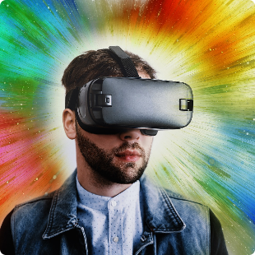

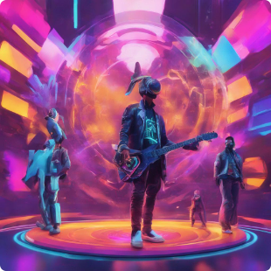
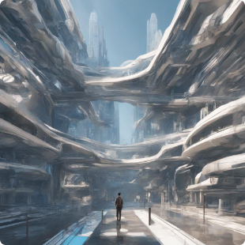
Use of NFTs in the Metaverse
Virtual Real Estate
Virtual Fashion
Music Industry
Digital Identity and Avatars
Experience unique digital fashion creations that can be worn exclusively in virtual worlds.
NFTs in the virtual music industry offer new revenue, ownership, fan engagement, transparent royalties, and creative collaborations
NFTs allow individuals to own virtual land, buildings, and assets within the metaverse, creating a new economy.
Create personalized digital identities and avatars that can be used across various virtual platforms.

Slide 8
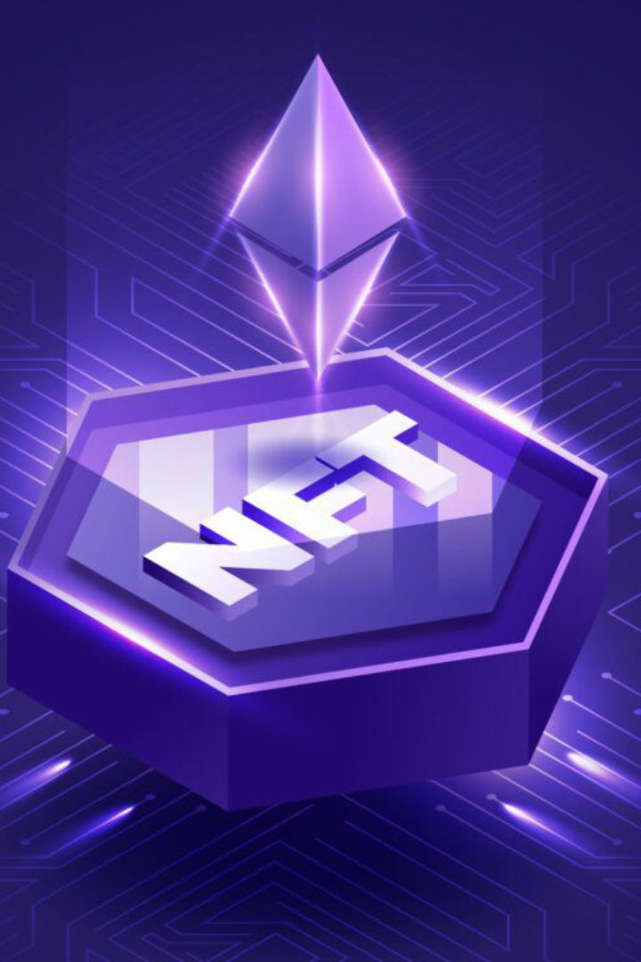
Conclusion
The widespread adoption of NFTs across different industries showcases their potential to revolutionize digital ownership, economy, and engagement in both the real-world and the metaverse.

Slide 9
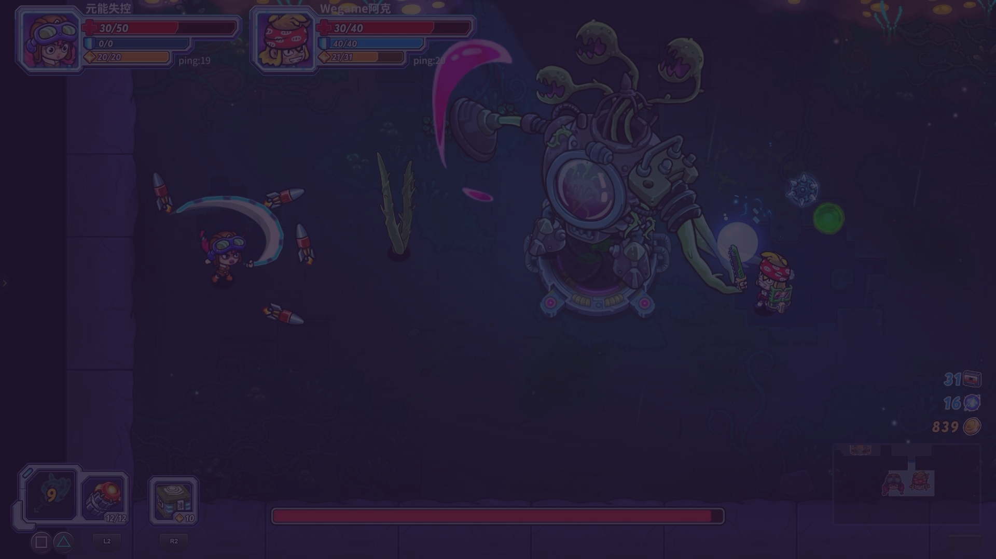
Future Scope of NFT Applications
Standards and Interoperability
Integration with AI and VR
Regulatory Framework
Evaluate the need for regulatory oversight and guidelines to protect investors and creators in the NFT space.
Develop common standards and protocols to enhance interconnectivity and compatibility across different NFT platforms.
Explore the integration of NFTs with artificial intelligence and virtual reality technologies for immersive experiences.
Expanding Use Cases
Identify new and innovative use cases for NFTs beyond art and collectibles, such as in gaming, music, and sports.

Slide 10
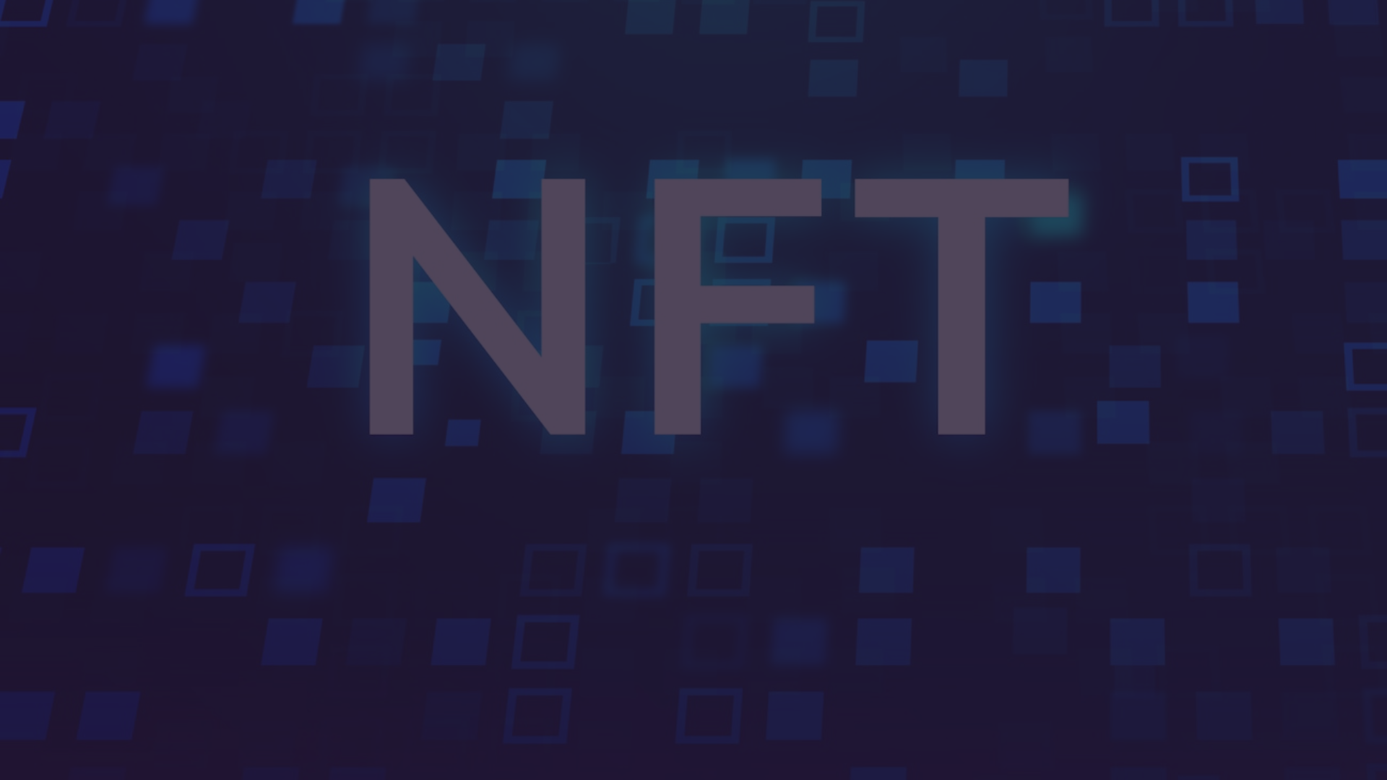
References
[1] https://www.sciencedirect.com/science/article/pii/S1877050922019482
[2] https://onlinelibrary.wiley.com/doi/abs/10.1002/jsc.2502
[3] https://clarivate.com/blog/metaverse-and-non-fungible-tokens-nfts-what-they-mean-for-ip/
[4] https://www.mdpi.com/1911-8074/15/5/215
[5] https://arxiv.org/abs/2208.04836
[6] https://ieeexplore.ieee.org/abstract/document/10070402/

